Slide 1






My home, My energy
I have the power!
My home, My energy … I have the power!
Today we’re going to learn some things about being safe with electric in our homes
Let’s Be Safe

Slide 2



My home, My energy
I have the power!
Let’s start by all introducing ourselves and say Hello

Slide 3





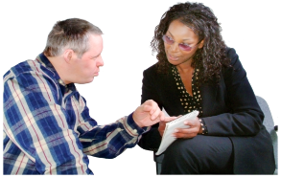
My home, My energy
I have the power!
How to stay Safe with
Electricity in the Home
Let’s Be Safe
Today we will be looking at:
How to be safe with electric in our home
Ten Top Tips for Electrical Safety

Slide 4
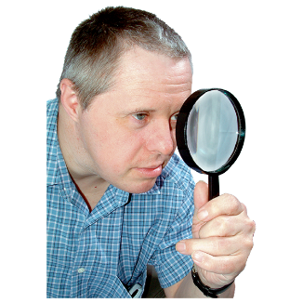
My home, My energy
I have the power!
Before we start let’s do a little exercise together:
How many different things do we use that need Electricity to make them work?
Who will keep the score?

Slide 5

My home, My energy
I have the power!
So what was the score?
Did you realise there are so many things?

Slide 6
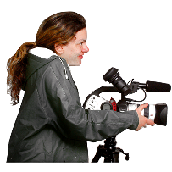

My home, My energy
I have the power!
Now we’ll watch a film Speakup has made called
“You just plug it in don’t you”
We can watch it by clicking on the link below
et’s Be Safe
You just plug it in don't you - Video
click

Slide 7

My home, My energy
I have the power!
Does anybody want to say anything about the things we saw in the film before we move on to the Top Tips?

Slide 8
My home, My energy
I have the power!
Let’s Be Safe
Top Tips for Electrical Safety

Slide 9
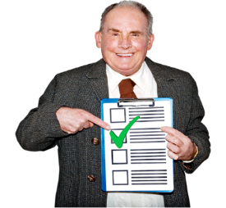
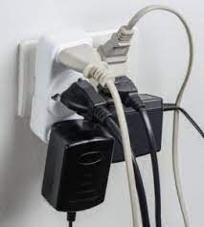
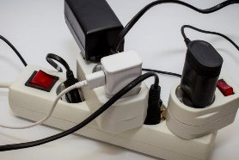
My home, My energy
I have the power!
Top Tip #1:
Don’t plug too many things into the same power socket
Extension leads can be useful but do not plug too many things into one lead
NEVER plug more than one heater into them
Top Tip
1

Slide 10
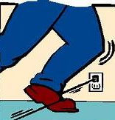
My home, My energy
I have the power!
Top tip #2:
Be careful with trailing wires, they can be easy to trip over
Make sure they are tidy
and out of the way
Top Tip
2

Slide 11
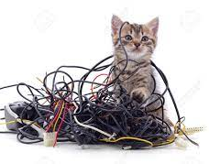
My home, My energy
I have the power!
Top tip #3:
Keep pets away from wires
So they don’t chew or play
with them
Top Tip
3

Slide 12
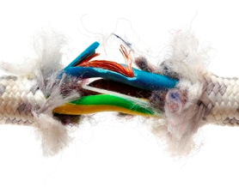
My home, My energy
I have the power!
Top tip #4:
Check wires to make sure they are safe
If they look damaged or worn
get them checked by an
electrician or replace them
Top Tip
4

Slide 13
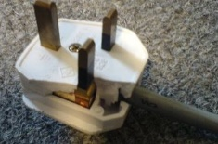
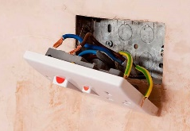

My home, My energy
I have the power!
Top tip #5:
Check your plugs to make sure they are safe
If they are broken or loose stop using them
Get them checked by an
electrician or replace them
Top Tip
5

Slide 14
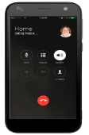
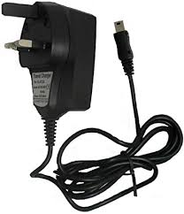
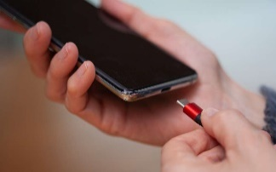

My home, My energy
I have the power!
Top tip #6:
Don’t leave mobile phone and tablet chargers plugged in overnight
If your charger gets too hot to touch unplug it
Get it checked by an electrician
or replace it
Top Tip
6

Slide 15
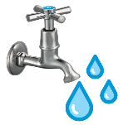
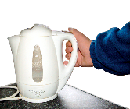
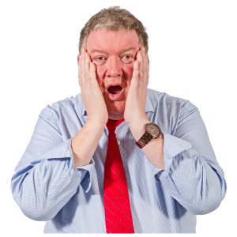
My home, My energy
I have the power!
Top tip #7:
In the kitchen …
Don’t over fill your kettle
if it overflows it can be dangerous
If you have wet hands and touch anything plugged then you might get an electric shock. This will hurt a lot and can kill you.
Top Tip
7

Slide 16
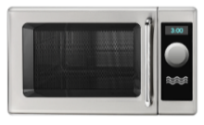
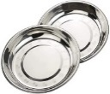

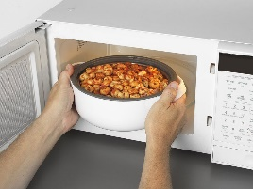
My home, My energy
I have the power!
Top tip #8:
Don’t put metal things in a microwave
Only use containers which are
‘microwave safe’
Be careful when you take things out … they might be hot!
Top Tip
8

Slide 17
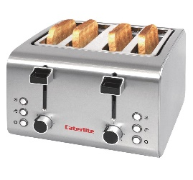
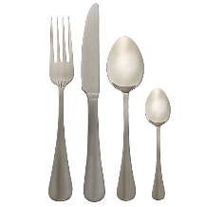
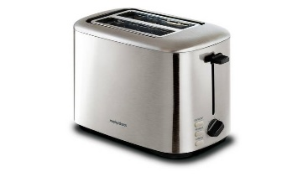
My home, My energy
I have the power!
Top tip #9:
If the toast gets stuck in your toaster:
Unplug it and let it cool down
Carefully try to get the toast out
NEVER use a knife, or anything metal to get things out of the toaster
Top Tip
9

Slide 18

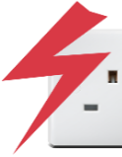
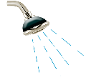
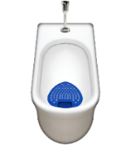
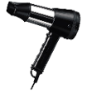
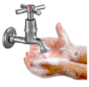
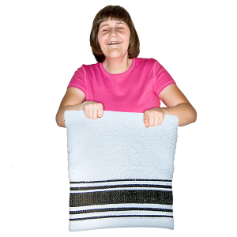
My home, My energy
I have the power!
Top tip #10:
Using electrical things near to water is very dangerous
Never take electrical things into the bathroom or shower
Always dry your hands before touching anything electrical
Top Tip
10

Slide 19



My home, My energy
I have the power!
Let’s finish with a Quiz to see what we have learned …
You can work on your own
Or you can work in groups
It’s just for fun
Let’s Be Safe
Quiz

Slide 20
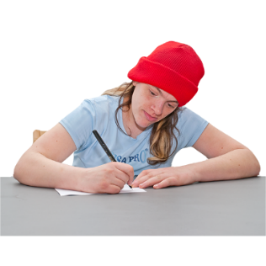
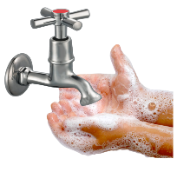

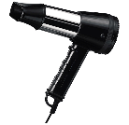


My home, My energy
I have the power!
Question 1
Is it safe to use a hairdryer when you have wet hands?
Yes
  No
  Not sure

Slide 21

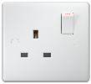
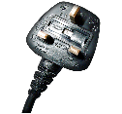
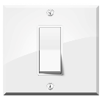
My home, My energy
I have the power!
Correct Answer: No
You should Never touch anything electrical if your hands are wet
Do not touch plugs or sockets
Do not touch light switches
Question 1

Slide 22

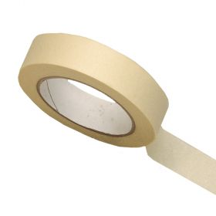
My home, My energy
I have the power!
Question 2
Is it safe to “mend” a damaged or worn wire with sticky tape?
Yes
  No
  Not sure

Slide 23

My home, My energy
I have the power!
Correct Answer: No
You should Never try to mend damaged or worn wires or cables
Call an Electrician
Question 2

Slide 24
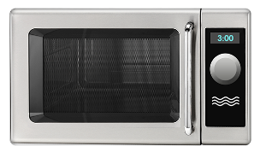
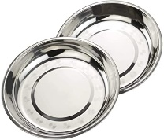
My home, My energy
I have the power!
Question 3
Can you use a metal dish or plate in a microwave?
Yes
  No
  Not sure

Slide 25
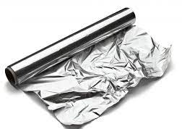
My home, My energy
I have the power!
Correct Answer: No
You should never put any metal objects or anything wrapped in tin foil in a Microwave
Question 3

Slide 26
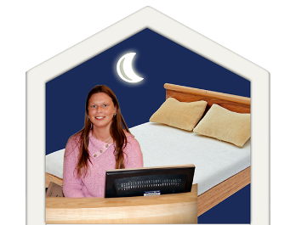
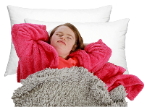
My home, My energy
I have the power!
Question 4
Is it safe to charge your mobile phone at night while you are in bed?
Yes
No
Not sure

Slide 27
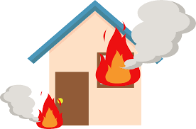
My home, My energy
I have the power!
Correct Answer: No
You should not charge your mobile phone at night while you are in bed
Mobile phone chargers can get too hot and have caused house fires
Only charge your phone in a safe place where you can see it and turn it off if it gets too hot
Question 4

Slide 28
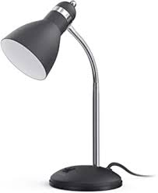

My home, My energy
I have the power!
Question 5
Should you turn off the switch before changing a light bulb?
Yes
No
Not sure

Slide 29
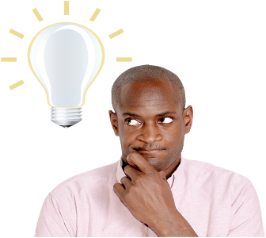
My home, My energy
I have the power!
Correct Answer: Yes
Before changing a light bulb it is safer if you turn the light off at the switch
Question 5

Slide 30
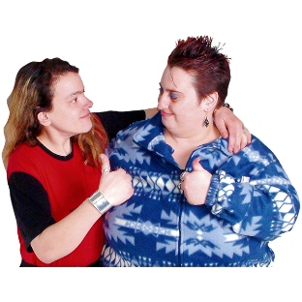


My home, My energy
I have the power!
How did we all do?
Don’t forget to tell a friend about keeping safe with Electricity at home
Let’s Be Safe
Speakup Self Advocacy 2022

