Slide 1

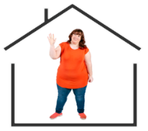



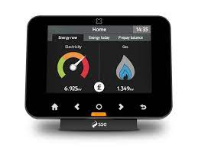


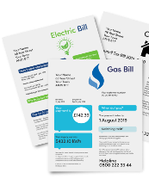
My home, My energy
I have the power!
Being Smart … Saving Energy … Saving Money
Smart Meters
Today we’re going to learn about
  Being Smart
  Saving Energy
  Saving Money
Let’s Be Smart

Slide 2



My home, My energy
I have the power!
Let’s start by all introducing ourselves and say Hello

Slide 3


My home, My energy
I have the power!
Let’s Be Smart
Today we are going to look at:
Smart Meters
And how they can help you save you money on your Gas and Electricity Bills

Slide 4


My home, My energy
I have the power!
Before we get to this let’s do a little exercise together:
Does anyone have a Smart Meter in their home?
Do you want to tell us about it and how you use it?

Slide 5


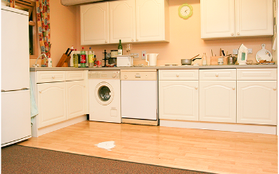
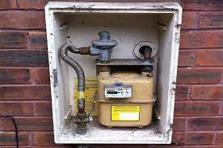
My home, My energy
I have the power!
?
If you don’t have a Smart Meter
Do you know where your Gas and Electricity Meters are in your home?
Sometimes they are hidden under a kitchen cupboard
Or sometimes outside

Slide 6
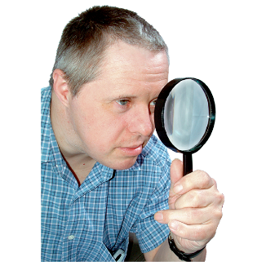
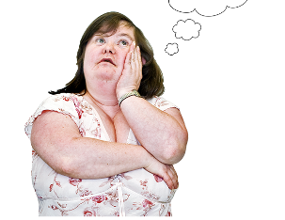
My home, My energy
I have the power!
They can be hard to find …
And hard to read and understand

Slide 7



My home, My energy
I have the power!
So what is good about a Smart Meter?
Let’s watch this film together
click
How do smart meters work?

Slide 8

My home, My energy
I have the power!
So what are the important things the film told us …

Slide 9

My home, My energy
I have the power!
1.
Your Smart Meter has an In Home Display Unit which shows how much Gas and Electricity you are using
You can put the display unit anywhere in your home that is best for you

Slide 10
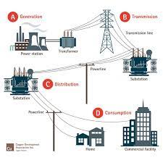


My home, My energy
I have the power!
2.
Your Smart Meter sends your meter readings to your Gas and Electricity supplier
You do not have to worry about reading the meters, or sending off the information

Slide 11
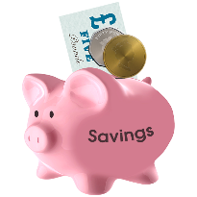
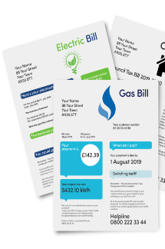
My home, My energy
I have the power!
3.
Knowing how much Gas and Electricity you are using can help you save money on your bills

Slide 12
My home, My energy
I have the power!
So is a Smart Meter right for you and your home?
Let’s look at the presentation which teaches you about Smart Meters.
click
Smart meter presentation

Slide 13


My home, My energy
I have the power!
Contact your Energy Supplier by Phone or Online
Ask for Smart Meters

Slide 14
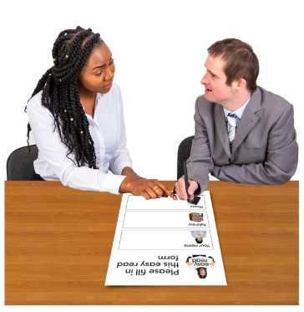
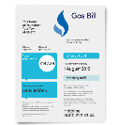
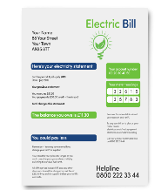
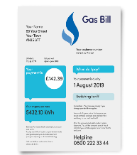
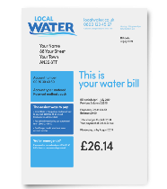


My home, My energy
I have the power!
Ask someone you trust to help you …
You can find the name of your Energy Supplier on your Bill
Or on the website of your Gas or Electricity supplier

Slide 15
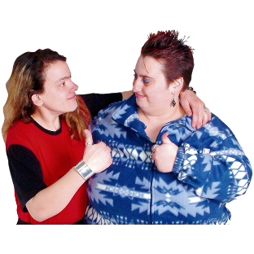


My home, My energy
I have the power!
Don’t forget to tell a friend about Smart Meters
Speakup Self Advocacy 2022

