Slide 1






My home, My energy
I have the power!
My home, My energy … I have the power!
Today we’re going to learn some things about being safe with Gas in our homes
Let’s Be Safe

Slide 2



My home, My energy
I have the power!
Let’s start by all introducing ourselves and say Hello

Slide 3
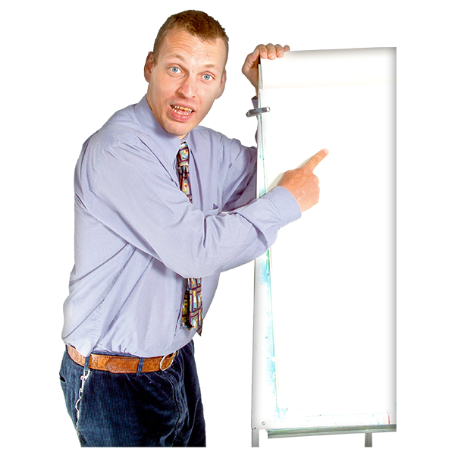


My home, My energy
I have the power!
Working together as a group …
What things do we have in our homes that need Gas to make them work?
Who will keep the score?
Gas in our homes?

Slide 4


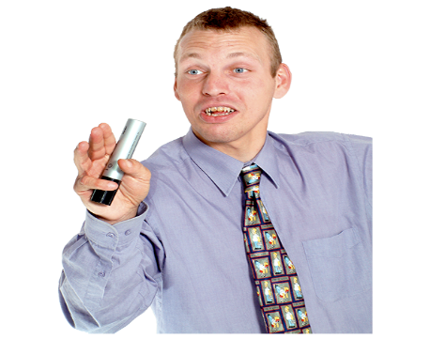
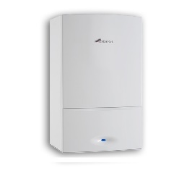
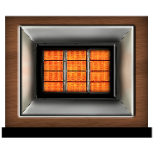
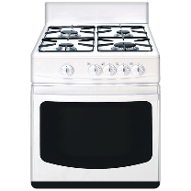
My home, My energy
I have the power!
So do we all agree … the main three things in our homes which use gas are:
Your boiler to heat water and the radiators
Gas fire
Cooker
How many things can we think of?

Slide 5

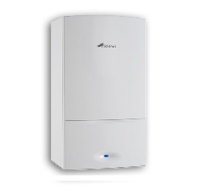
My home, My energy
I have the power!
Today we’re going to learn some things about being safe with Gas in our homes
A Gas Leak from any of these things we use in our homes would be very dangerous
Let’s Be Safe

Slide 6
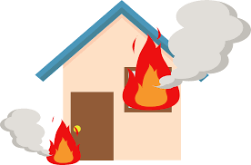
My home, My energy
I have the power!
It could cause an explosion and a fire

Slide 7
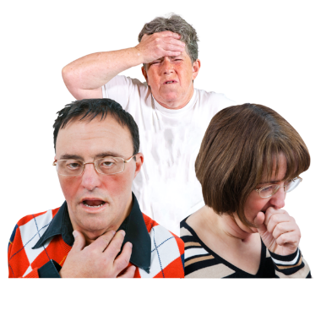




My home, My energy
I have the power!
Or it might make us very ill
Let’s watch a Speakup film
Click the link to watch the film
I Can’t smell it so it must be safe - Film
click

Slide 8
My home, My energy
I have the power!
Anybody want to say anything about the things we saw in the film
There is more information about Carbon Monoxide poisoning on the Speakup website
I Can’t smell it so it must be safe
click

Slide 9
My home, My energy
I have the power!
Before we look at Top Tips let’s remind ourselves about some of the signs of Carbon Monoxide Poisoning

Slide 10
My home, My energy
I have the power!
Some Signs of Carbon Monoxide Poisoning
Dizziness
Feeling Sick
Headache
Stomach Pains
Feeling Out of Breath

Slide 11



My home, My energy
I have the power!
If these signs disappear when you leave your home for fresh air …
It could be that you have a Carbon Monoxide leak

Slide 12
My home, My energy
I have the power!
Speakup has produced posters to tell people about the signs of Carbon Monoxide Poisoning
There are 4 examples on our poster
Full size Posters can be downloaded for free from the Speakup website
I Can’t smell it so it must be safe - Posters
click

Slide 13
My home, My energy
I have the power!
Let’s Be Safe
Top Tips for Gas Safety in Your Home

Slide 14







My home, My energy
I have the power!
Top Tip #1:
Know what you need to be aware of to be safe from Carbon Monoxide:
You cannot See Carbon Monoxide Gas
You cannot Smell Carbon Monoxide Gas
Carbon Monoxide Gas leaks are very dangerous
Top Tip
#1

Slide 15


My home, My energy
I have the power!
Top Tip #2:
Have all your Gas Appliances like boilers, gas fires and cookers serviced by a professional
Once a year is good
Top Tip
#2
2022
2023
2024

Slide 16
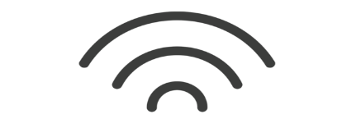
My home, My energy
I have the power!
Top Tip #3:
Get Carbon Monoxide Alarms
Put them in the room where you have a gas fire, gas cooker or gas boiler
They will sound an Alarm if there is a danger from Carbon Monoxide
Top Tip
#3

Slide 17

My home, My energy
I have the power!
Top Tip #4:
If your alarm goes off or you think you have a Carbon Monoxide leak
Leave your home immediately
Top Tip
#4

Slide 18



My home, My energy
I have the power!
Top Tip #5:
Call Gas Emergency Helpline if you think you have a gas leak or your Carbon Monoxide Alarm goes off
0800 111 999
Top Tip
#5

Slide 19


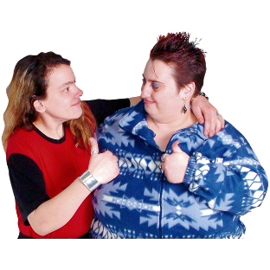
My home, My energy
I have the power!
Top Tip #6:
Tell a friend about being safe with Gas in your home
Top Tip
#5
Let’s Be Safe

Slide 20
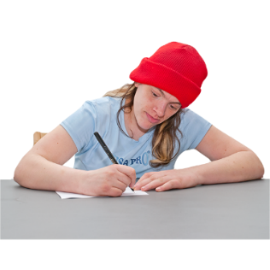
My home, My energy
I have the power!
I Can’t Smell It … So It Must Be Safe Quiz
Do the quiz online, it will help you see what you have learnt?
Go to the Speakup website to download the quiz here:
Carbon Monoxide Quiz
click

Slide 21


My home, My energy
I have the power!
Tell a friend about being safe with Gas in our homes
Let’s Be Safe
Speakup Self Advocacy 2022

