Slide 1
You’ve Been Sharked

Slide 2
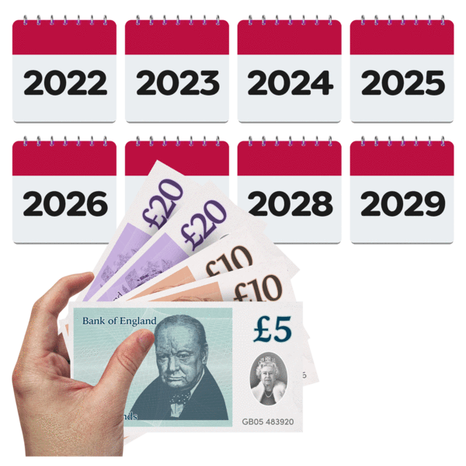
What is a loan shark
A loan shark is someone who tries to lend you money at very high rates of interest and they might threaten you.
A loan shark wants to make money. They lend you money and then charge a lot of interest on top.

Slide 3
What is interest?
If you get a loan from a bank or a loan shark, you will have to pay more money back than you borrowed.
This extra money is called ‘interest’.
But the interest you get charged from a loan shark is a LOT more than at the bank or post office.

Slide 4
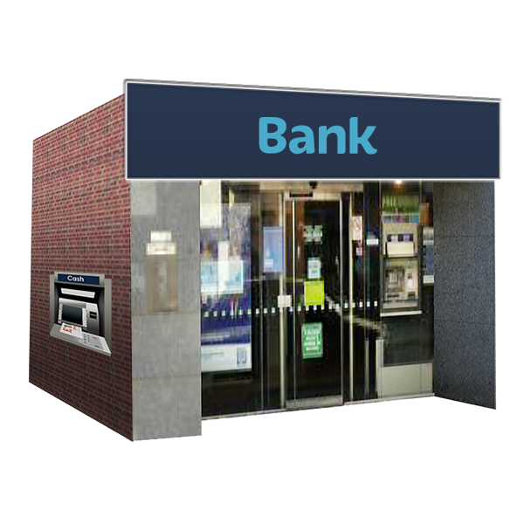
What is interest?
A bank might lend you £100 and charge you 10% interest.
This means if you borrow £100 you will pay back £110.
But a loan shark might lend you £100 and ask you to pay back £200, or even more!
10 %
10 %
£100
£110
£200

Slide 5
Loan Sharks
Loan sharks are people who do not have permission to lend money. But they do because they want to make a lot of money from you.
They charge lots and lots of interest. Remember interest is what is charged on top of the loan and has to be paid back.

Slide 6
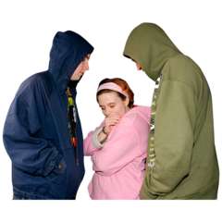
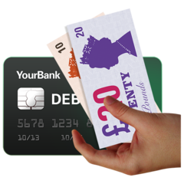
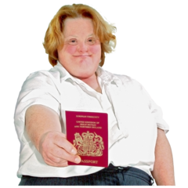
Loan Sharks
Loan sharks may offer you a cash loan but:
•they might not give you any paperwork
• they might charge huge amounts of interest
•they might take your bank card, passport, jewellery, watch or benefits information.

Slide 7
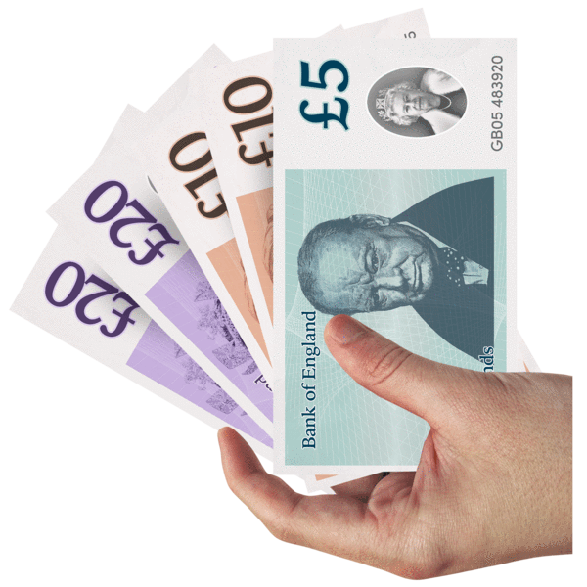
Paying back a Loan Shark
It’s hard to pay back a loan shark because they keep on wanting more and more money.
If you miss a payment they might threaten you or other members of your family.

Slide 8
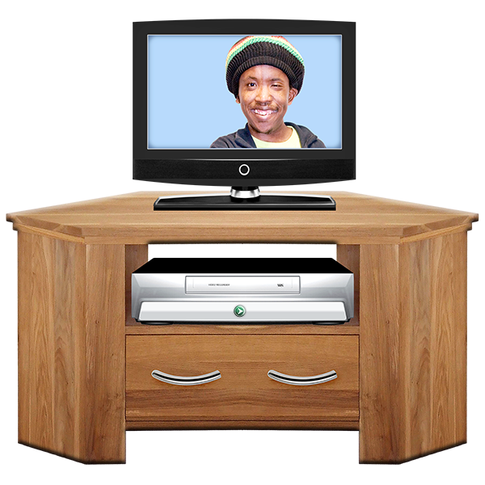
Paying back a Loan Shark
They might take your things such as your TV or jewellery.
They might also pretend to be your friend then threaten to tell others about your debt.

Slide 9
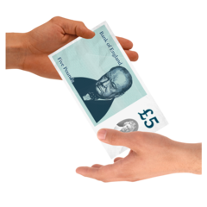
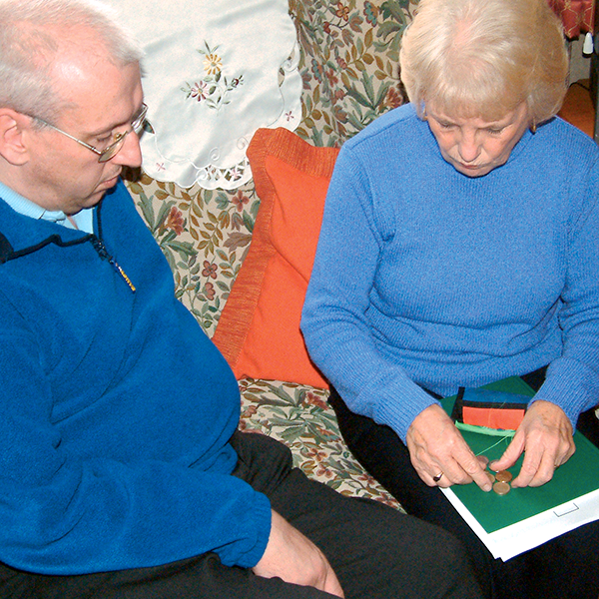
If you need a loan
If you need a loan, first of all go to your bank, the post office or credit union. If they cannot help, go to citizens advice and ask them for help with your budgeting.
Sometimes family members may be able to help. But, you may still need some help with your budgeting because a loan will need to be paid back.

Slide 10
If you need a loan
Needing a loan may be a big worry, but:
Always check out who is saying they can lend you the money.
Ask someone you trust if you do not understand what they are saying you need to do, to pay the money back.
Ask for advice from someone you trust if you still need a loan after budgeting advice is given.

Slide 11
If you need a loan
Do not be tempted to buy from anyone who offers you a loan without you understanding the interest and the time allowed to pay it back.
Always make sure there is paperwork to prove the agreement, in case things go wrong in the future.

Slide 12
Don’t be sharked
Taking a loan out with a loan shark can be very frightening, dangerous and stressful.
Ask for help and support from someone you trust if you have done this.

Slide 13
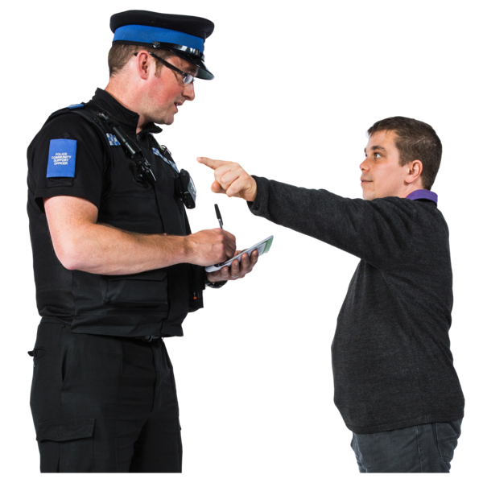
Don’t be sharked
If you are involved with a loan shark and they start to threaten you, tell the police. You could do this without giving your name if you feel the loan shark is dangerous. If you have told the police and the loan shark has become threatening tell the police again on their emergency number.
If you can, go to a place where you feel safe until this is sorted, this might be helpful. Only tell people you trust where you are.

Slide 14
Don’t be sharked
If you are involved with a loan shark and they are not threatening but you are paying them back a lot of money, ask for advice about what to do next.

Slide 15
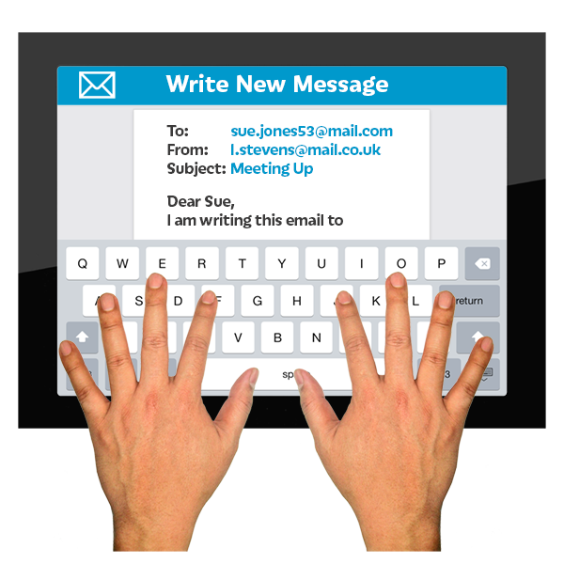
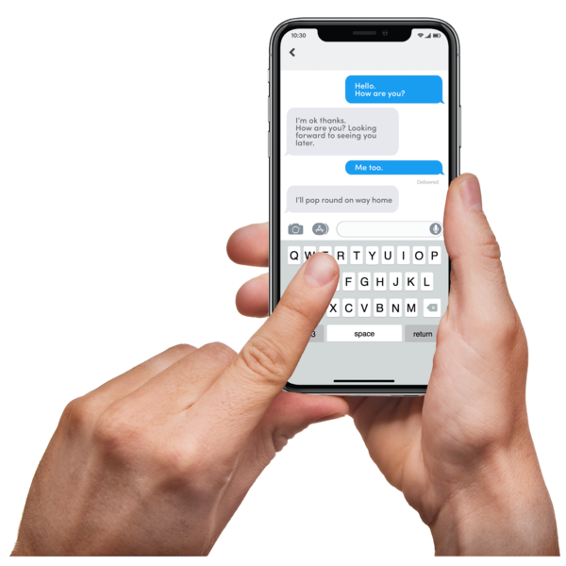
Who to contact if you’ve been sharked?
If you or someone you know has been the victim of a loan shark contact:
Illegal Money Lending Team
Email:reportaloanshark@stoploansharks.gov.uk
Telephone: 0300 555 2222
Text: 07860 022 116

