Slide 1








My home, My energy
I have the power!
My home, My energy … I have the power!
Today we’re going to learn some things about the Water, Gas and Electricity Supplies in our Homes

Slide 2



My home, My energy
I have the power!
Let’s start by all introducing ourselves and say Hello

Slide 3




My home, My energy
I have the power!
Ok, let’s start by having a Quick Quiz to find out what you know about …
  The Water supply
  The Gas supply
  The Electricity supply
In your home

Slide 4


My home, My energy
I have the power!
You can work on your own
Or you can work in groups
It’s just for fun
My home,
My energy
Quick Quiz

Slide 5

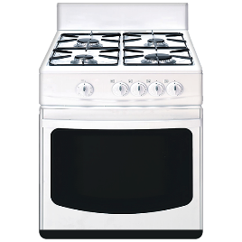

My home, My energy
I have the power!
Question 1
In your kitchen …
Is your oven
  Gas
  (b) Electric
  (c) I don’t know

Slide 6


My home, My energy
I have the power!
Question 2
In your bathroom …
What heats your water?
  Gas
  (b) Electric
  (c) I don’t know

Slide 7
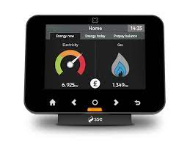


My home, My energy
I have the power!
Question 3
In your home …
For checking Gas and/or Electricity readings do you have a Smart Meter?
  Yes
  (b) No
  (c) I don’t know

Slide 8
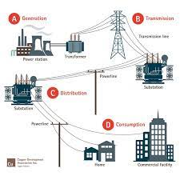

My home, My energy
I have the power!
Question 4
Do you know the name of your Electricity Supplier?
  Yes
  (b) No
  If you answered Yes … Who is it?

Slide 9



My home, My energy
I have the power!
Question 5
Do you know the name of your Water Supplier?
  Yes
  (b) No
  If you answered Yes … Who is it?

Slide 10





My home, My energy
I have the power!
Question 6
Are you on the
Priority Services Registers
for Water, Gas and Electricity?
  Yes
  (b) No
  (c) I don’t know

Slide 11



My home, My energy
I have the power!
How did we all do?
Don’t worry if you didn’t know all the answers
It was just for fun
But it would be a good idea to find out which companies supply Water, Gas and Electricity to your Home

Slide 12

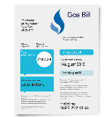
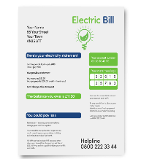
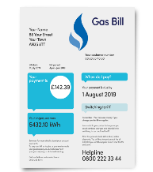
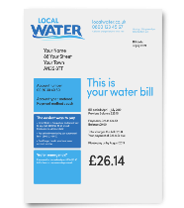


My home, My energy
I have the power!
Ask someone you trust to help you …
You can find the company name on your Bill
Or on the Websites

Slide 13
My home, My energy
I have the power!
Now we’re going to look at …
The Priority Services Registers for:
    Water
    Gas
    Electricity

Slide 14
My home, My energy
I have the power!
Priority Services …
This means that you may get Extra Services from your Water, Gas and Electricity Suppliers

Slide 15

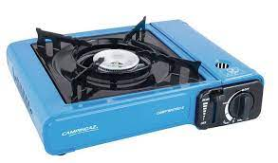
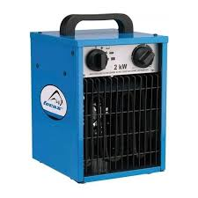
My home, My energy
I have the power!
Extra Services such as …
Telling you before a planned power cut happens
Telling you when the water has to be turned off
Making sure you have supplies of bottled water when the water is turned off
Making sure you have a different way of cooking or heating your home when the power is off

Slide 16



My home, My energy
I have the power!
For more information about Priority Services you can work through this Easyread information together:
Priority Services for Water
Priority Services for Gas and Electricity
www.speakup.org.uk
click
Priority Services for Water - Easyread
click
Priority Services for Gas and Electricity - Easyread

Slide 17

My home, My energy
I have the power!
Ask someone you trust to help you look on the Speakup website for more information:
The Speakup Website
click

Slide 18

My home, My energy
I have the power!
Now let’s watch a video about Priority Services
And how we can get on The Priority Services Registers
Prioritise Me film

Slide 19

My home, My energy
I have the power!
Let’s have another Quiz
See what we have learned
You can work on your own
But it might be more fun to work as a group
I have the power

Slide 20



My home, My energy
I have the power!
Question 1
All Water, Gas and Electricity Suppliers have a Priority Services Register?
Yes
  No
  Not sure

Slide 21

My home, My energy
I have the power!
Correct Answer: Yes
All Water, Gas and Electricity Companies have a Priority Services Register
This means that you may get Extra Services from your Water, Gas and Electricity Suppliers
Question 1

Slide 22


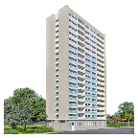
My home, My energy
I have the power!
Question 2
I can be on the Priority Services Register if …
I have a pet
I have a Learning Disability or Autism
I live in a flat

Slide 23




My home, My energy
I have the power!
Question 2
Correct Answer:
I have a Learning Disability or Autism
If you have a Learning Disability or Autism you have the right to be on the Priority Services Register
All other reasons why you could be on the Priority Services Register can be found on the Speakup website
Prioritse Me - Easyread
click

Slide 24




My home, My energy
I have the power!
Question 3
An Extra Service I might get from the Priority Services Register
A different way to cook or to heat my home in a power cut
Free cans or bottles of beer if the water is turned off
A new coat and scarf to keep me warm if the power goes off

Slide 25


My home, My energy
I have the power!
Correct Answer:
  If there is a power cut your Energy Company may provide you with a different way to cook or to heat your home
  Your Water Company may provide you with bottles of drinking water
  But not free cans of beer
Question 3

Slide 26
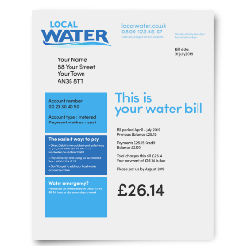

My home, My energy
I have the power!
Question 4
If you are on the Priority Services Register you can ask for a Large Print Bill?
Yes
  No
  Not sure

Slide 27
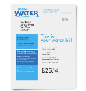

My home, My energy
I have the power!
Correct Answer: Yes
All Utility Companies – Water, Gas and Electricity will send you Large Print Bills if you ask
For information on all Priority Services visit the Speakup website
Question 4
Prioritise Me
click
Prioritise My Water
click

Slide 28
My home, My energy
I have the power!
Question 5
I now know about the Priority Services Registers for Water, Gas and Electricity and I will be able tell a friend …
Yes
        No
        Not sure

Slide 29
My home, My energy
I have the power!
Question 5
Correct Answer: Yes
All Water, Gas and Electricity Companies have a Priority Services Register
If you answered ‘No’ or ‘Not Sure’ then you might like to go through this again another day

Slide 30



My home, My energy
I have the power!
Tell a friend about the Priority Services Registers
Speakup Self Advocacy 2022

