Slide 1






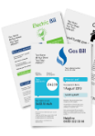

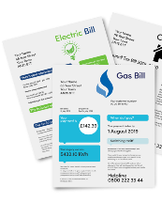
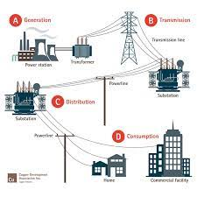



My home, My energy
I have the power!
Saving Energy … Saving Money Getting Help With Your Energy Bills
Today we’re going to look at some of the ways …
You could save money on your home Energy Bills
And you could get help to pay your home Energy Bills
Energy Bill Savings

Slide 2



My home, My energy
I have the power!
Let’s start by all introducing ourselves and say Hello

Slide 3


My home, My energy
I have the power!
How many different ways do we use Gas and Electricity in our Homes?
Working together let’s think of the things we have in our homes that need Gas or Electricity to make them work
Who wants to keep the score?
Gas and Electricity

Slide 4


My home, My energy
I have the power!
Did you think there would be so many different ways we use Gas and Electricity?
Let’s not forget we have to pay for all the Gas and Electricity we use
Gas and Electricity

Slide 5




My home, My energy
I have the power!
The News is telling us that the bills we will have to pay for our Gas and Electricity are going up …
Price Increases

Slide 6


My home, My energy
I have the power!
So what can we do to use less Gas and Electricity and save money on the bills?
What help can we get to pay the bills?

Slide 7
My home, My energy
I have the power!
Let’s start by looking at what we can do to use less Gas and Electricity
And save money on our Gas and Electricity bills
Here are three good ideas

Slide 8



My home, My energy
I have the power!
1.
Having a Smart Meter in Home Display Unit shows how much Gas and Electricity you are using
Knowing how much Gas and Electricity you use may help you to check things out
And make some changes to how you use the Gas and Electricity in your home

Slide 9

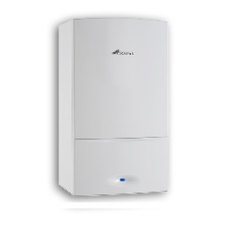

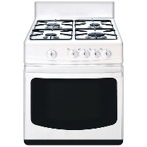
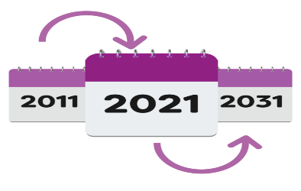
My home, My energy
I have the power!
2.
Having your Gas Appliances such as boiler, gas fire, cooker, serviced once a year by a professional is a good idea
If you live in a council property this will happen anyway
It makes sure they are safe, working well and not wasting Gas and your money
2022
2023
2024

Slide 10



My home, My energy
I have the power!
3.
In rooms you are not using:
Turn off the lights
Turn down the radiators using the radiator valve

Slide 11
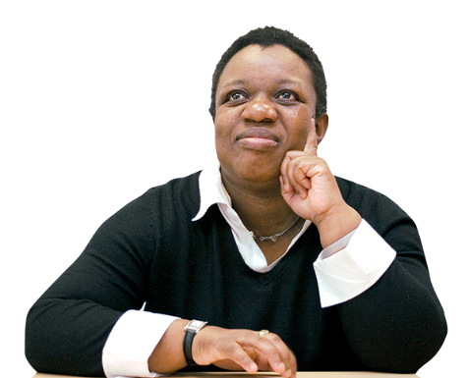


My home, My energy
I have the power!
Can anyone think of more?
You can look at some more Energy and Money saving ideas on the Speakup website
And watch the Speakup film
“I’m an expert energy saver”
Energy saving in the home - Easyread
click
I'm an Expert Energy Saver - Video
click

Slide 12
My home, My energy
I have the power!
Now let’s look at the help we may be able to get to pay our Energy Bills

Slide 13

My home, My energy
I have the power!
At the moment the Government has four different ways to help people pay their Gas and Electricity bills
1 £200
2 Cold Weather
3 Winter Fuel
4 Warm Home

Slide 14

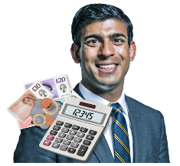
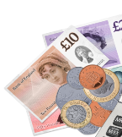
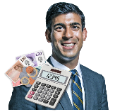



My home, My energy
I have the power!
1.
This year 2022 the Government is giving most households £200 towards their Energy Bills
You do not have to apply for this £200, it will be given directly to your Energy Company to help pay your bill

Slide 15
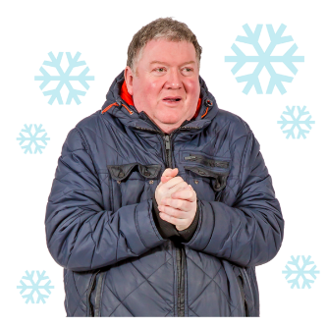
My home, My energy
I have the power!
2.
Cold Weather Payment
In Winter when it is very cold for 7 days you may be given £25 towards your Heating Bills

Slide 16




My home, My energy
I have the power!
Cold Weather Payment
Not everyone will get this money
To see if you can have this money go to …
You may need to ask someone you trust to help you
?
click
Cold Weather Payment: Can I get it?
www.gov.uk

Slide 17
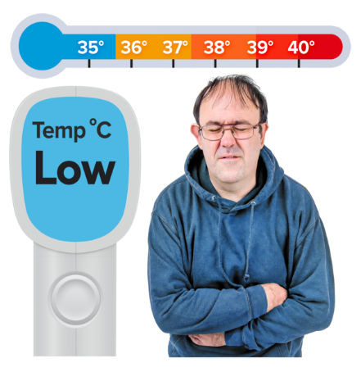

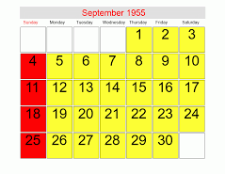
My home, My energy
I have the power!
3.
Winter Fuel Allowance
Some people may get a Winter Fuel Allowance of between £100 and £300 to help them pay their Winter Heating Bills
You will be paid this money directly if you were born on or before 26th September 1955

Slide 18
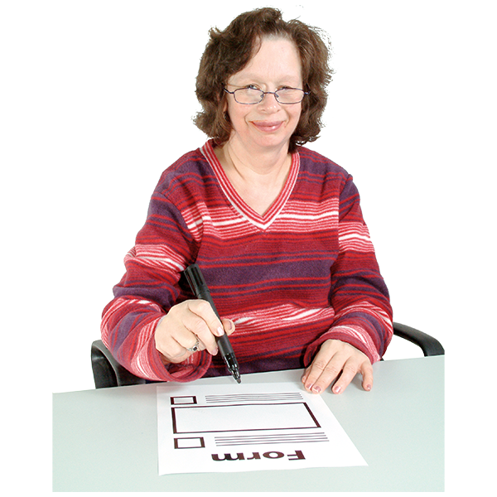


My home, My energy
I have the power!
3.
Winter Fuel Allowance
Not everyone will get this money
To see if you can have this money go to …
You may need to ask someone you trust to help you
click
Warm Home Discount Scheme
www.gov.uk

Slide 19
My home, My energy
I have the power!
4.
Warm Home Discount
Some people may be able to claim £140 Warm Home Discount from their Gas or Electricity Supplier
Check with your Supplier to find out

Slide 20



My home, My energy
I have the power!
Don’t forget to tell a friend about Saving Energy and Saving Money
And getting help with their Energy Bills
Speakup Self Advocacy 2022

